Slide 1
PYNQ Classification - Python on Zynq FPGA for Convolutional Neural Networks
Group Member: Nguyen Vu Le Minh P76087099
Tran Thi Ai P76087081
Notes:
Hello everyone, today I present the paper, the paper is FINN A Framework for Fast, Scalable Binarized Neural Network Inference.

Slide 2
Outline
Introduction
Background
Implementation
Experimental Result
Notes:
There are five session in my presentation. Introduction
Introduction
Background
Implementation
Experimental Result

Slide 3
Introduction
Motivation :
The computational overhead of a deep neural network based on CPU or GPU is too large.
FPGAs are particularly suitable for low-precision arithmetic and small memory footprint of binary data, which can reach the level of TOPS.
Propose:
Constructing a fast FPGA prototyping framework for high performance CNN deployment on PYNQ platform.
Design a framework optimally utilizes both the ARM core and FPGA hardware, delivering state-of-the-art CNN deployment speed, accuracy and power consumption
Notes:
Convolutional Neural Networks (CNNs) have achieved a significant amount of success in solving a wide range of classification problems.
There are many reason to make this project:
Motivation :
The computational overhead of a deep neural network based on CPU or GPU is too large.
FPGAs are particularly suitable for low-precision arithmetic and small memory footprint of binary data, which can reach the level of TOPS.
Propose:
Constructing a fast FPGA prototyping framework for high performance CNN deployment on PYNQ platform.
Design a framework optimally utilizes both the ARM core and FPGA hardware, delivering state-of-the-art CNN deployment speed, accuracy and power consumption

Slide 4
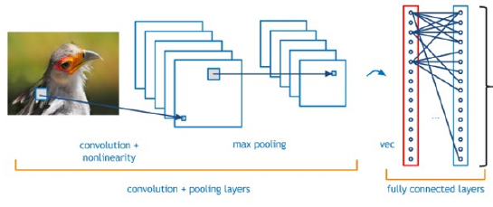
Background
Convolution Neural Network
The basic algorithm of a CNN is very similar to a common neural network.
The most frequently-used CNN layers are convolution layers, pooling layers, ReLU layers and fully-connected layers.
Notes:
Now, We will present the background.
Convolutional Neural Networks are currently considered to be an extremely effective and flexible algorithm, reaching state-of-the-art results in terms of accuracy in fields such as image classification.
The most frequently-used CNN layers are convolution layers, pooling layers, ReLU layers and fully-connected layers.

Slide 5
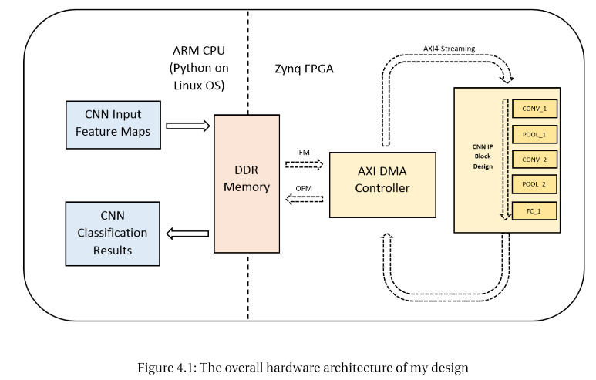
IMPLEMENTATION
The architecture of my design can be separated into two parts, namely ARM Linux OS implementation and Zynq FPGA implementation.
The ARM CPU side which is controlled by Python on Linux OS. This side controls the high level interface of my framework, where the framework loads input feature maps to DDR memory and outputs the classification results.
The right half of the diagram shows the Zynq FPGA side which is hardware-configured by overlay IP.
Notes:
The architecture of my design can be separated into two parts, namely ARM Linux OS implementation and Zynq FPGA implementation. The left half of the diagram shows the ARM CPU side which is controlled by Python on Linux OS. This side controls the high level interface of my framework, where the framework loads input feature maps to DDR memory and outputs the classification results. The right half of the diagram shows the Zynq FPGA side which is hardware-configured by overlay IP.

Slide 6
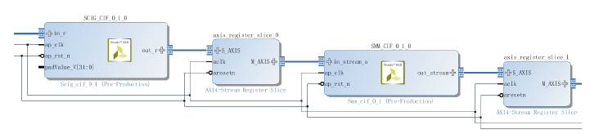
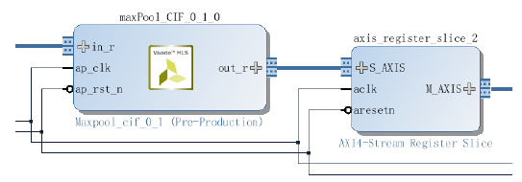
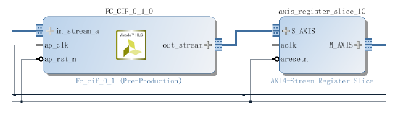
IMPLEMENTATION
Convolution Layer
Pooling Layer
Fully Connected Layer
Notes:
Three CNN layers, namely convolution layer, pooling layer, and fully-connected layer, have been constructed
using Vivado HLS. ReLU layer was included in each of the three layers.
(Pooling layer performs down-sampling on input feature map, by outputting maximumor average of subgraphs.
In AXI4-Streaming interface, pooling can be performed in similar concepts to sliding window unit.Fully-connected layer performs dot-product between input feature map and weights. Hence, in the off-line, a fully-connected layer can be easily converted into convolution layer.)

Slide 7
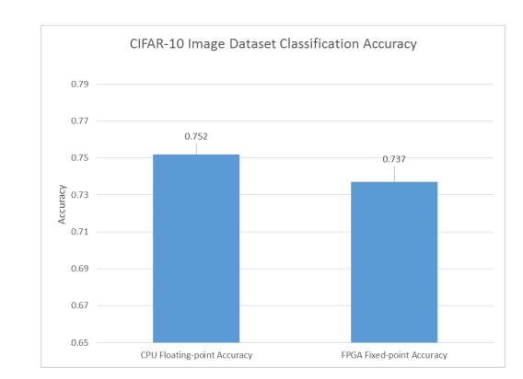
Experimental Result
Comparison between CPU implementation accuracy using 32-bit floating-point format, and FPGA implementation accuracy using 16-bit fixed-point format
With the CIFAR-10 testing dataset, the pretrained model weights can achieve a test accuracy of 75.2% using 32-bit floating-point format
With FPGA implementation incurs an accuracy loss of 1.5% due to 16-bit fixed-point quantization.
Notes:
Comparison between CPU implementation accuracy using 32-bit floating-point format, and FPGA implementation accuracy using 16-bit fixed-point format
With the CIFAR-10 testing dataset, the pretrained model weights can achieve a test accuracy of 75.2% using 32-bit floating-point format. Figure 8.2 shows that my FPGA implementation incurs an accuracy loss of 1.5% due to 16-bit fixed-point quantisation

Slide 8
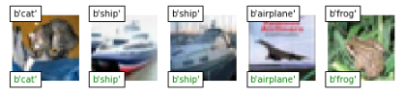
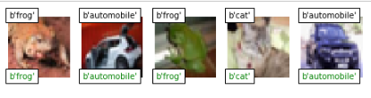
Experimental Result
Notes:
This is Examples of classifications in CIFAR-10 dataset. Digits on the upper-left corner are correct labels, and digits on the lower-left corner are predicted labels

Slide 9
Demo

Slide 10
Thanks for your listening

